Slide 1
PROJECT 2
Database Concepts
Spring 2021
Week 10

Slide 2
Requirement for Project #2
60 pts.
ERD (connectivities, cardinalities, PKs, FKs, relationship participation) (30pts)
Specialization hierarchy (Subtype discriminator, disjoint/overlapping constraint, total/partial constraint) (5 pts)
Be able to forward-engineer (15 pts)
Each table (except the entity subtype) must include five records; Number of record in entity subtype depends on data values in entity supertype (10pts)
40 pts.
Four SQL queries and query result sets using MySQL Workbench (40pt)

Slide 3
Requirement
Extra credit (5 pts)
5pts: Additional data entries (five more records per entity using INSERT INTO SQL statements)
Submit your .zip file (includes mwb and word document) via project 2 submission link on canvas by Apr. 4 (11:59 pm)

Slide 4
Business rules
A department employs one or many employees, and each employee is employed by none or one department.
An employee may manage one department (zero or one), and each department is managed by one and only one employee.
An employee must be either a full time or a part time employee. (full/partial)
An employee cannot be both a full time and a part time employee. (o/d)
A division operates one or many departments, and each department is operated by only one division.
One of the employees runs zero or one division, and each division is run by only one employee.
An employee may be assigned many projects (zero or many), and a project is assigned to one or many employees.
Notes:
Department employs Employee relationship: One-to-Many relationship. Department is optional in this relationship.
Division operates Department relationship: one-to-Many relationship. Both entities are mandatory in this relationship.
Employee has Project relationship: Many-to-Many relationship. Need to create an associative entity (called assignment) to split it to two one-to-many relationship.
Employee has Assignment relationship: One-to-Many relationship. Assignment is optional in this relationship.
Project has Assignment relationship: One-to-Many relationship. Both entities are mandatory in this relationship.
Employee manages Department relationship: One-to-One relationship. Department is optional in this relationship.
Employee runs Division relationship: One-to-One relationship. Division is optional in this relationship.

Slide 5
Required attributes
Department: name, street, city, state, zip, phone, email
Employee: first name, last name, type, street, city, state, zip, phone, email
Part_time: hourly rate, max hour per week
Full_time: Anual salary
Division: name, phone, email
Assignment: name, start_date, end_date, evaluation, note
Project: name, note

Slide 6
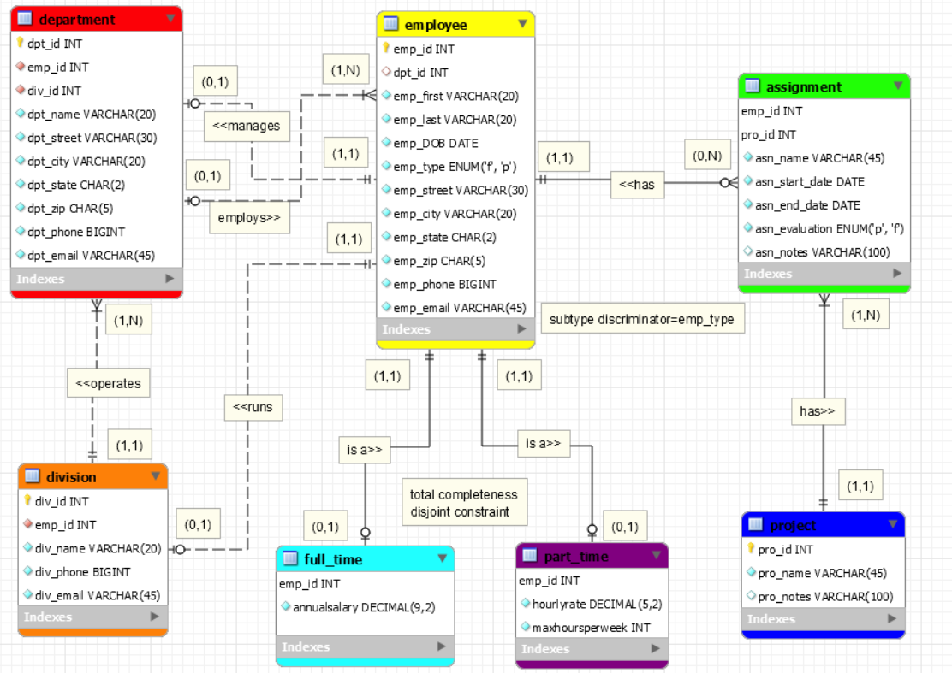
Notes:
Department employs Employee relationship: One-to-Many relationship. Department is optional in this relationship.
Division operates Department relationship: one-to-Many relationship. Both entities are mandatory in this relationship.
Employee has Project relationship: Many-to-Many relationship. Need to create an associative entity (called assignment) to split it to two one-to-many relationship.
Employee has Assignment relationship: One-to-Many relationship. Assignment is optional in this relationship.
Project has Assignment relationship: One-to-Many relationship. Both entities are mandatory in this relationship.
Employee manages Department relationship: One-to-One relationship. Department is optional in this relationship.
Employee runs Division relationship: One-to-One relationship. Division is optional in this relationship.

Slide 7
Forward Engineering

Slide 8
Forward Engineering
Cut

Slide 9
Forward Engineering
Paste

Slide 10
Four SQL statement questions
Use LIKE
Use EXISTS
Use GROUP BY
4. Use two SQL Built-in functions in a single statement

Slide 11
LIKE
Select Attributename(s) from Tablename
where Attributename like 'a%’;
Select Attributename(s) from Tablename
where Attributename like ’%a’;
Select Attributename(s) from Tablename
where Attributename like ’%a%’;
Select Attributename(s) from Tablename
where Attributename like ’_a%’;
Select Attributename(s) from Tablename
where Attributename like 'a%o’;

Slide 12
EXISTS
Select Attributename(s) from parent table
where exists
(select Attributename(s) from child table
where parent table. (Pk)attribute name=child table. (FK) attribute name);

Slide 13
Group By
Only used when in conjunction with one of the SQL aggregate functions (COUNT, MIN, MAX, AVG, and SUM) in the SELECT statement
SQL execution sequence
SELECT COUNT(attribute 1), attribute2
FROM table name
GROUP BY attribute 2;
Choose an attribute ( attribute 1) which contain numerical data value to work with!

Slide 14
Two SQL Built-in functions
Select
format (avg(attribute name),decimal place) as ‘avg’,
format (max(attribute name),decimal place) as ‘max’,
format (min(attribute name),decimal place) as ‘min’
from table name;

